Slide 1

4th International Conference on Mechanical, Industrial and Material Engineering (ICMIME), 17-19 December 2019, Rajshahi, Bangladesh
Modeling of a 5R Robotic Manipulating System with 5DoF using GUI MatLab Simulation
Presented by
Rajshahi University of Engineering & Technology

Slide 2
4th International Conference on Mechanical, Industrial and Material Engineering (ICMIME), 17-19 December 2019, Rajshahi, Bangladesh
Outlines
Motivation Behind the Work
Literature Review
Objectives
Mathematical Model
Graphical User Interface
SolidWorks Modeling and Simulink Simulation
Experimental Model
Future Work
Conclusion
Modeling of a 5R Robotic Manipulating System with 5DoF using GUI MatLab Simulation
1

Slide 3
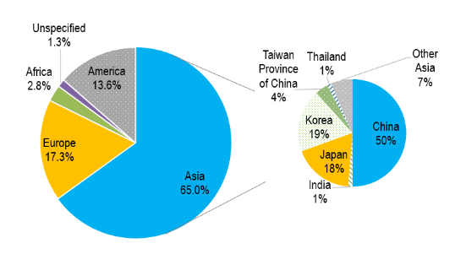
4th International Conference on Mechanical, Industrial and Material Engineering (ICMIME), 17-19 December 2019, Rajshahi, Bangladesh
Motivation behind the Work
Increased Accuracy
Higher Quality
Improved Working Environment
Increased Profitability
Longer Working Hour
Fig.1: Industrial Robots used in Asia by 2017 [1]
[1] IMFBlog, online: https://blogs.imf.org/2018/08/29/chart-of-the-week-invest-in-robots-and-people-in-asia/, last access: 12/8/2019
Modeling of a 5R Robotic Manipulating System with 5DoF using GUI MatLab Simulation
2

Slide 4
4th International Conference on Mechanical, Industrial and Material Engineering (ICMIME), 17-19 December 2019, Rajshahi, Bangladesh
Literature Review
Mohammed and Sunar [2]
Forward Kinematic Model with D-H Parameter Table
Inverse Kinematics Model with Trigonometric Approach
[2] A. A. Mohammed, M. Sunar, “Kinematics modeling of a 4-DOF robotic arm”, IEEE International Conference on Control, Automation and Robotics, May 2015.
Modeling of a 5R Robotic Manipulating System with 5DoF using GUI MatLab Simulation
11/29/2019
3

Slide 5
4th International Conference on Mechanical, Industrial and Material Engineering (ICMIME), 17-19 December 2019, Rajshahi, Bangladesh
Literature Review
Cekus and Posiadala [3]
SolidWorks Model
Kinematic Model with D-H Forward Kinematic Approach
MATLAB SimMechanics Link Simulation
[3] D. Cekus, B. Posiadala and P. Warys, “Integration of Modeling in SolidWorks and MatLab/simulink Environments” in Archive of Mechanical Engineering, 2014.
Modeling of a 5R Robotic Manipulating System with 5DoF using GUI MatLab Simulation
4

Slide 6
4th International Conference on Mechanical, Industrial and Material Engineering (ICMIME), 17-19 December 2019, Rajshahi, Bangladesh
Literature Review
Joy [4]
3 DoF Experimental Model
Color Sorting Ability
[4] A. Joy, “Object sorting robotic arm based on colour sensing”, International Journal of Advanced Research in Electrical, Electronics and Instrumentation Engineering, Vol. 3, March 2014.
Modeling of a 5R Robotic Manipulating System with 5DoF using GUI MatLab Simulation
5

Slide 7
Objectives
4th International Conference on Mechanical, Industrial and Material Engineering (ICMIME), 17-19 December 2019, Rajshahi, Bangladesh
To establish a mathematical model of a robotic arm and do a mechanical design for the arm
To provide a perfect simulation model
To build the experimental model and interface with color sensor
To establish the gripper operation
Modeling of a 5R Robotic Manipulating System with 5DoF using GUI MatLab Simulation
6

Slide 8
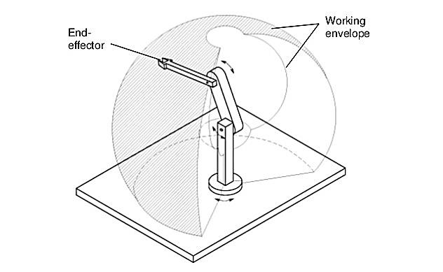
4th International Conference on Mechanical, Industrial and Material Engineering (ICMIME), 17-19 December 2019, Rajshahi, Bangladesh
Robotic Manipulator
Robotic Manipulator or Arm is one kind of mechanical body, usually programmable, which performs the same or similar function to human arm.
Categories of Industrial Robotic Arms:
Cartesian Robot
Cylindrical Manipulator
Articulated Manipulator
Spherical Manipulator
Selective Compliance Articulated
Robotic Arm (SCARA)
Fig.2: Articulated Manipulator.
Modeling of a 5R Robotic Manipulating System with 5DoF using GUI MatLab Simulation
7

Slide 9
4th International Conference on Mechanical, Industrial and Material Engineering (ICMIME), 17-19 December 2019, Rajshahi, Bangladesh
Mathematical Model
Forward Kinematics
D-H Frame Rule
Z axis must be the axis of revolution or direction of motion
X axis must be perpendicular to Z axis of the frame before it
X axis must intersect Z axis of the frame before it
Y axis must be drawn so the whole frame follows right hand rule
Modeling of a 5R Robotic Manipulating System with 5DoF using GUI MatLab Simulation
8

Slide 10
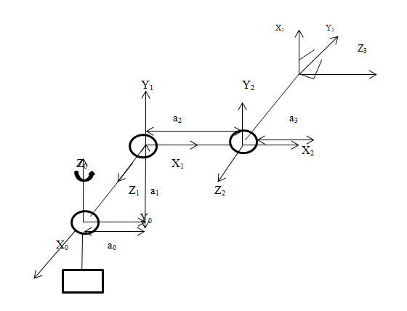
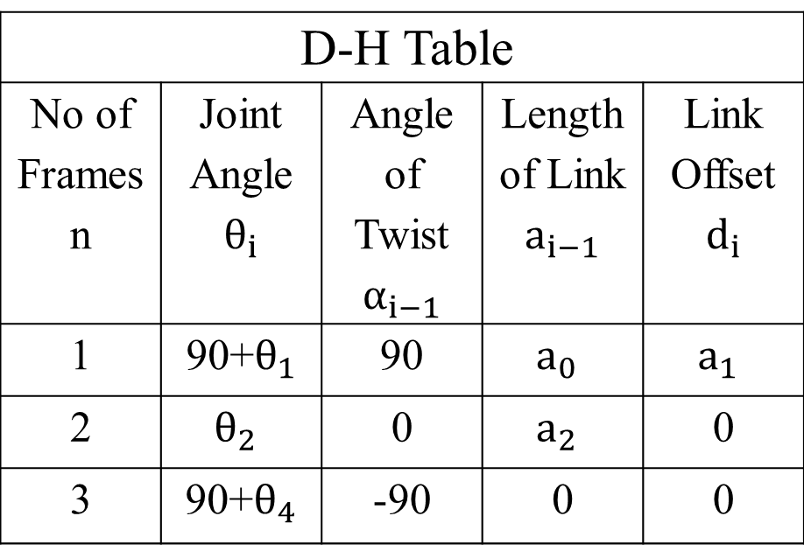
4th International Conference on Mechanical, Industrial and Material Engineering (ICMIME), 17-19 December 2019, Rajshahi, Bangladesh
Kinematic Scheme and D-H Parameter Table
Table 1: D-H Parameter Table
D-H Table
No of Frames n | Joint Angle $$θ_{i}$$ | Angle of Twist$α_{i−1}$ | Length of Link $$a_{i−1}$$ | Link Offset $$d_{i}$$
1 | 90+$θ_{1}$ | 90 | $$a_{0}$$ | $$a_{1}$$
2 | $$θ_{2}$$ | 0 | $$a_{2}$$ | 0
3 | 90+$θ_{4}$ | -90 | 0 | 0
Fig.3: Kinematic Scheme of the Robotic Arm
Modeling of a 5R Robotic Manipulating System with 5DoF using GUI MatLab Simulation
9

Slide 11
4th International Conference on Mechanical, Industrial and Material Engineering (ICMIME), 17-19 December 2019, Rajshahi, Bangladesh
Forward Kinematics Results
Position and Rotation of the End Effector with respect to the Base Frame
Modeling of a 5R Robotic Manipulating System with 5DoF using GUI MatLab Simulation
10

Slide 12
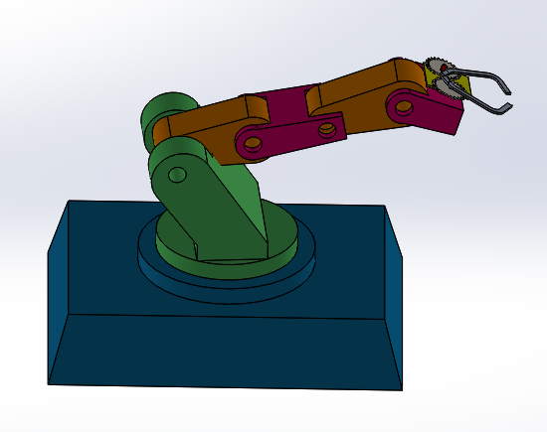
4th International Conference on Mechanical, Industrial and Material Engineering (ICMIME), 17-19 December 2019, Rajshahi, Bangladesh
Simulation Model
Modeling of a 5R Robotic Manipulating System with 5DoF using GUI MatLab Simulation
10

Slide 13
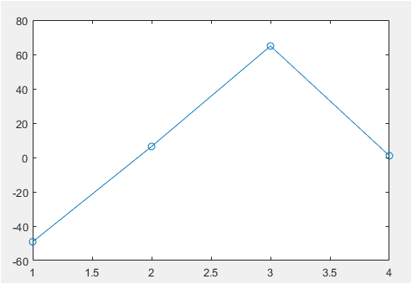
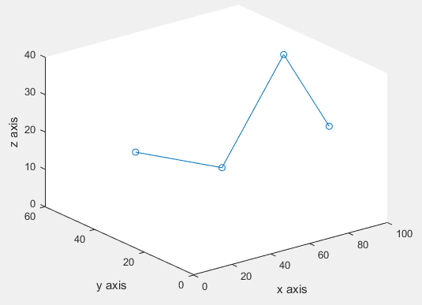
4th International Conference on Mechanical, Industrial and Material Engineering (ICMIME), 17-19 December 2019, Rajshahi, Bangladesh
Graphical User Interface
Fig.6: Robotic arm output with initial slider position
Fig.7: Robotic arm in 3D plotting
Modeling of a 5R Robotic Manipulating System with 5DoF using GUI MatLab Simulation
13

Slide 14
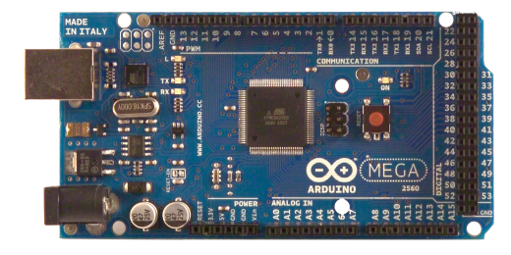
4th International Conference on Mechanical, Industrial and Material Engineering (ICMIME), 17-19 December 2019, Rajshahi, Bangladesh
Experimental Model: Components
Arduino MEGA 2560
Operating Voltage: 5V
Digital I/O pin: 54
Analog Input Pins: 16
DC Current per I/O pin: 40mA
DC Current for 3.3V pin: 50mA
Fig.10: Arduino Mega 2560.
Modeling of a 5R Robotic Manipulating System with 5DoF using GUI MatLab Simulation
17

Slide 15
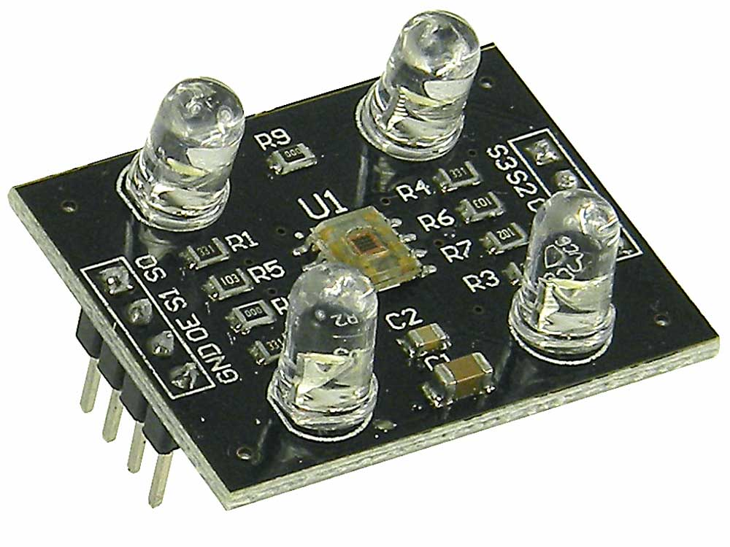
4th International Conference on Mechanical, Industrial and Material Engineering (ICMIME), 17-19 December 2019, Rajshahi, Bangladesh
Experimental Model: Components
TCS230 Color Sensor
Power: 2.7V to 5.5V
Photodiode
Array
Current to Frequency Converter
Light
Fig.11: Functional block diagram of the color sensor
Fig.11: TCS 230 color sensor
Modeling of a 5R Robotic Manipulating System with 5DoF using GUI MatLab Simulation
18

Slide 16
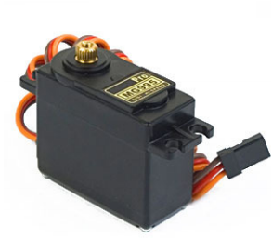
4th International Conference on Mechanical, Industrial and Material Engineering (ICMIME), 17-19 December 2019, Rajshahi, Bangladesh
Experimental Model: Components
Servo Motors
Tower Pro MG 995
Gear Type: Metal gear
Operating voltage: 4.8~ 6.6V
Current draw at idle: 10mA
No load operating current draw: 170mA
Fig.12: MG 995 servo motor
Modeling of a 5R Robotic Manipulating System with 5DoF using GUI MatLab Simulation
19

Slide 17
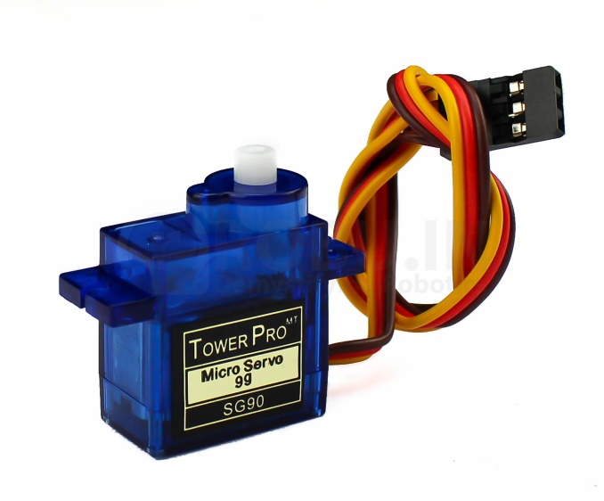
4th International Conference on Mechanical, Industrial and Material Engineering (ICMIME), 17-19 December 2019, Rajshahi, Bangladesh
Experimental Model: Components
Servo Motors
Micro Servo SG 90
Power supply: 3 - 6 V
Current consumption: 550 mA
Fig.13: SG 90 Servo motor
Modeling of a 5R Robotic Manipulating System with 5DoF using GUI MatLab Simulation
20

Slide 18
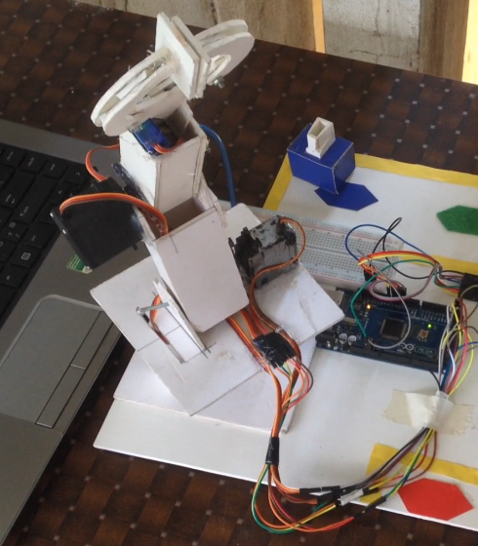
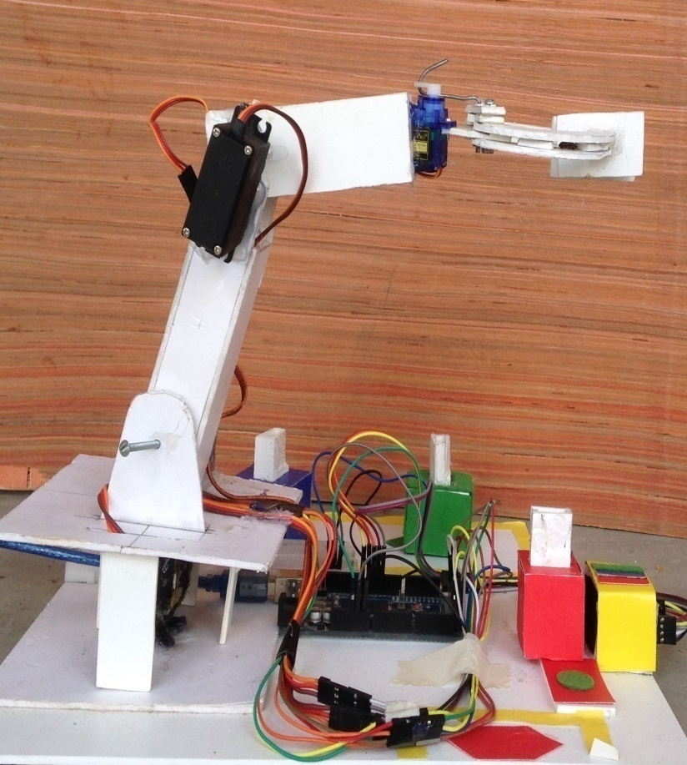
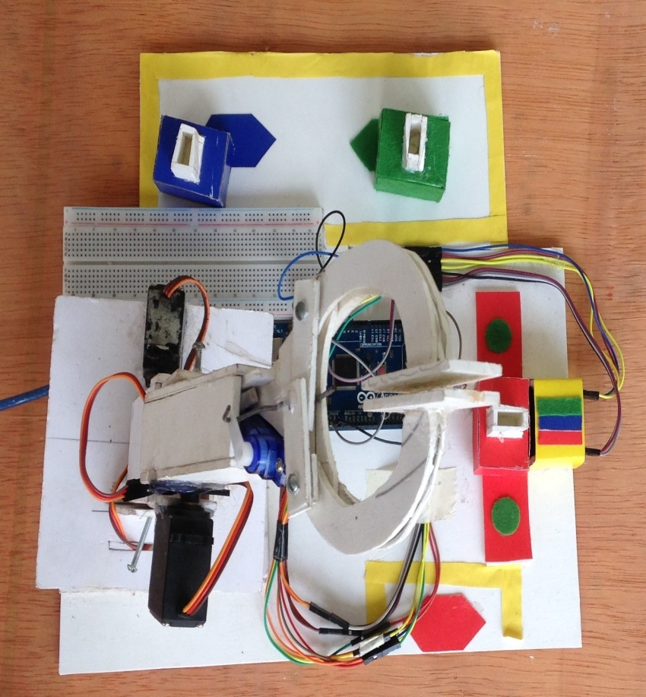
4th International Conference on Mechanical, Industrial and Material Engineering (ICMIME), 17-19 December 2019, Rajshahi, Bangladesh
Experimental Model
Fig.14: Experimental Model of the Robotic Arm
Modeling of a 5R Robotic Manipulating System with 5DoF using GUI MatLab Simulation
21

Slide 19
4th International Conference on Mechanical, Industrial and Material Engineering (ICMIME), 17-19 December 2019, Rajshahi, Bangladesh
Future Scope
Following modifications can be done for further development
Image Sensor
Stainless Steel Bar
Conveyor Belt
Modeling of a 5R Robotic Manipulating System with 5DoF using GUI MatLab Simulation
23

Slide 20
4th International Conference on Mechanical, Industrial and Material Engineering (ICMIME), 17-19 December 2019, Rajshahi, Bangladesh
Conclusion
Mathematical Modeling has been done.
Mechanical Drawing has been simulated using SimMechanics Link.
Experimental Model has been built.
Modeling of a 5R Robotic Manipulating System with 5DoF using GUI MatLab Simulation
24

Slide 21
4th International Conference on Mechanical, Industrial and Material Engineering (ICMIME), 17-19 December 2019, Rajshahi, Bangladesh
Thank You
Modeling of a 5R Robotic Manipulating System with 5DoF using GUI MatLab Simulation
25

Slide 22
4th International Conference on Mechanical, Industrial and Material Engineering (ICMIME), 17-19 December 2019, Rajshahi, Bangladesh
Scopes of Work
Brick Sorter
Vegetable Separator According to Color
Separation Avoider of Medicines in Pharmaceutical Industries
Plastic Sorter by Color
Chocolate Packaging Assistance
Modeling of a 5R Robotic Manipulating System with 5DoF using GUI MatLab Simulation
27

Slide 23

HT MATRIX
4th International Conference on Mechanical, Industrial and Material Engineering (ICMIME), 17-19 December 2019, Rajshahi, Bangladesh
Modeling of a 5R Robotic Manipulating System with 5DoF using GUI MatLab Simulation
28

Slide 24
HT MATRIX
4th International Conference on Mechanical, Industrial and Material Engineering (ICMIME), 17-19 December 2019, Rajshahi, Bangladesh
Modeling of a 5R Robotic Manipulating System with 5DoF using GUI MatLab Simulation
29

Slide 25
MATRIX CALCULATION
4th International Conference on Mechanical, Industrial and Material Engineering (ICMIME), 17-19 December 2019, Rajshahi, Bangladesh
Modeling of a 5R Robotic Manipulating System with 5DoF using GUI MatLab Simulation
30

Slide 26
4th International Conference on Mechanical, Industrial and Material Engineering (ICMIME), 17-19 December 2019, Rajshahi, Bangladesh
Reference of Mathematical Modeling
[2] A. A. Mohammed, M. Sunar, “Kinematics modeling of a 4-DOF robotic arm”, IEEE International Conference on Control, Automation and Robotics, May 2015.
Modeling and Development of a 3 DoF Color Sorting Robotic Manipulator using Arduino
33

